Slide 1
2-Bit Gray Code Up Counter
A gray code counter is one in which the output only differs by one bit from its prior value.
This type of counter can be implemented using state-encoded outputs by simply encoding the states in gray code

Slide 2
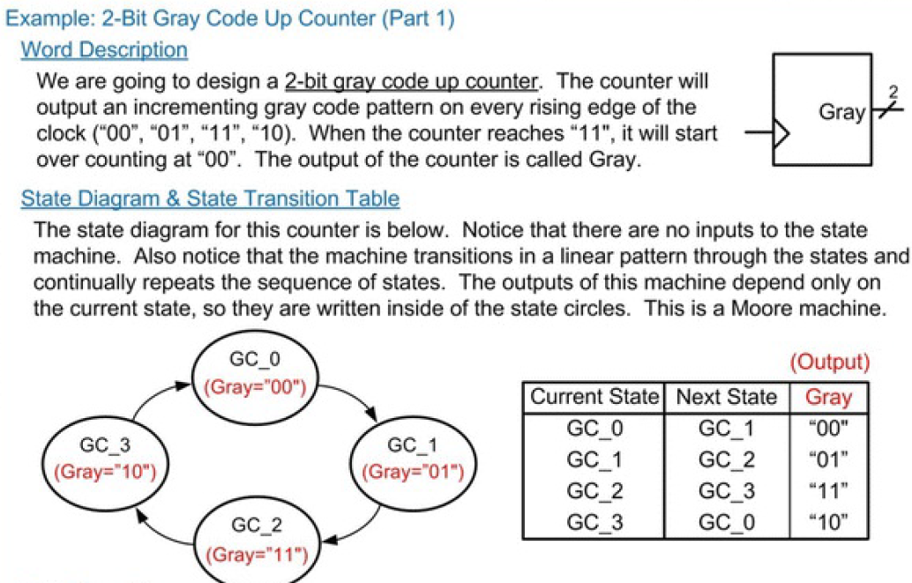

Slide 3
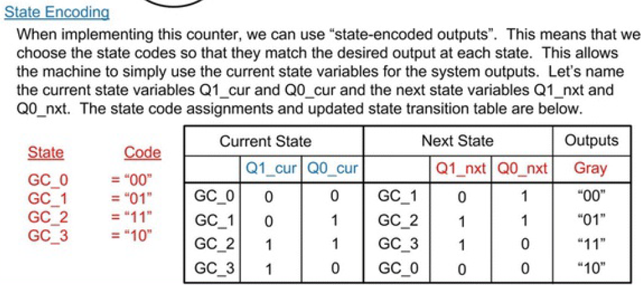
2-Bit Gray Code Up Counter

Slide 4
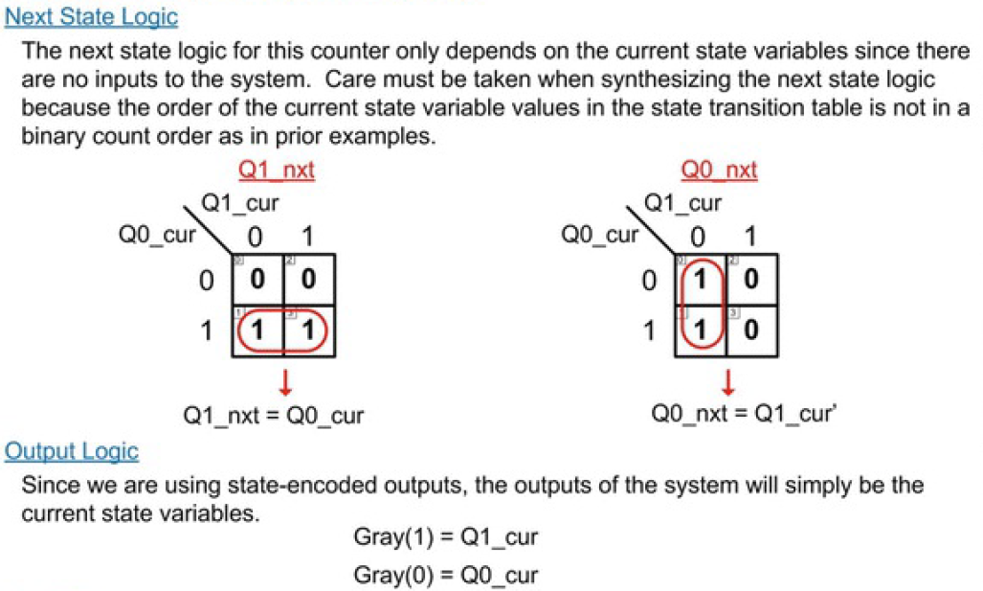

Slide 5
